Slide 1
Camico Sales Data Insights
Presented By :
Spectral Tech Analytics Team

Slide 2
Accounts and Opportunities

Slide 3
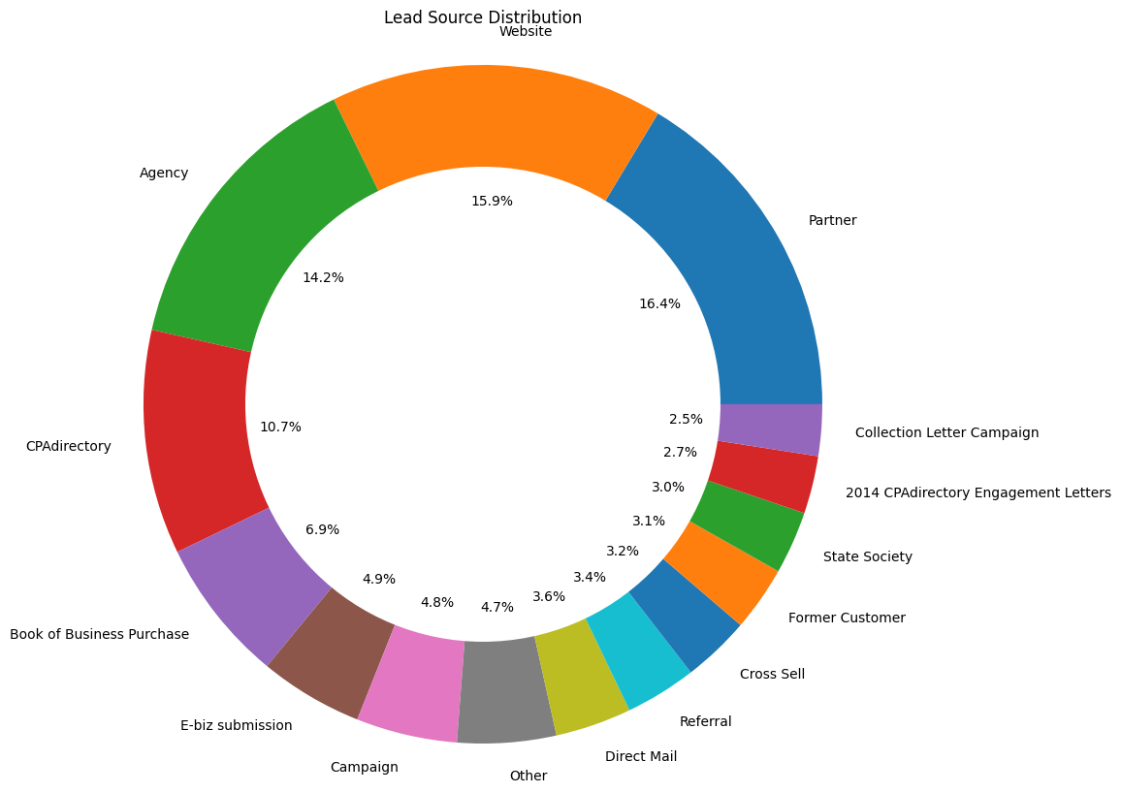
Lead Source Distribution
Conclusion:
Partner, Website, Agency, and
CPAdirectory are the leading
contributors of lead generation.

Slide 4
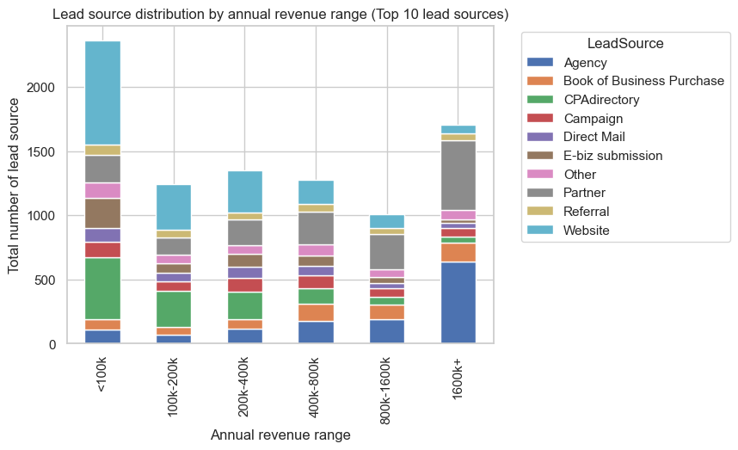
Lead Source v/s Annual Revenue
Conclusion:
Agency and Partner are the key contributors to generating opportunities with high annual revenues.
Website and CPAdirectory are the primary contributors to generating opportunities with low annual revenues.

Slide 5
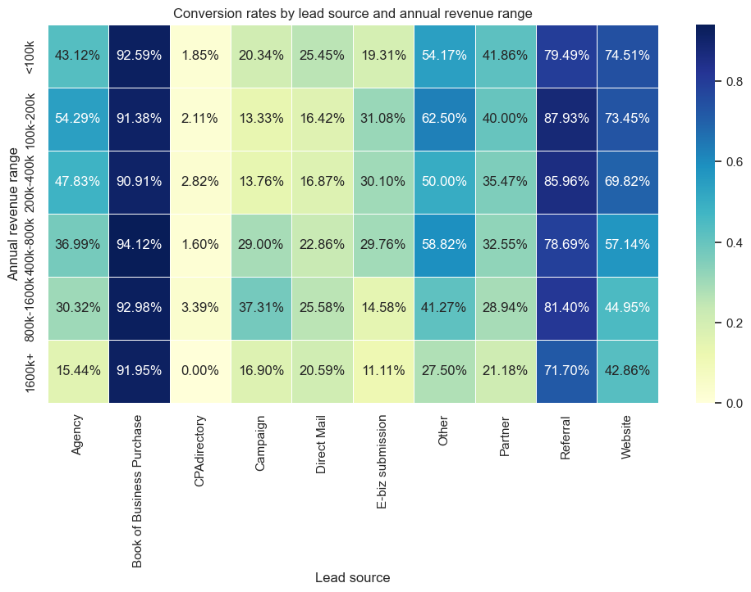
HeatMap: Lead Source(X) vs Annual Revenue(Y)
Conclusion:
Book of Business Purchase and Referrals consistently exhibit a high conversion ratio across all revenue brackets.
In contrast, CPAdirectory shows an almost negligible conversion ratio across all brackets.
Other lead sources tend to have a lower conversion ratio for leads with higher annual revenue.
Agencies demonstrate a lower conversion ratio for leads with higher annual revenue in comparison to those with lower annual revenue.
While CPAdirectory stands out as a major lead source, it registers the lowest conversion rate.
Website displays a lower conversion ratio for leads with lower annual revenue, compared to the higher annual revenue.
Across various lead sources, there is a consistent trend of decreasing conversion rates as the annual revenue increases.

Slide 6
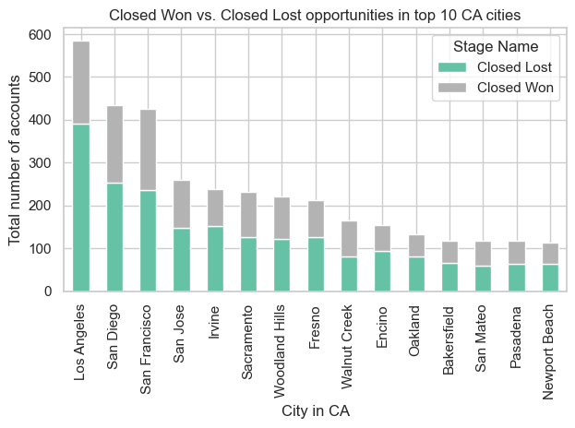
Conversion Comparison in CA Cities
Conclusion:
No significant variation or trend was observed in the Conversion Ratio across different cities.
Across almost all cities, approximately 35% of leads are successfully closed as 'won,' while the others are marked as 'lost'.

Slide 7
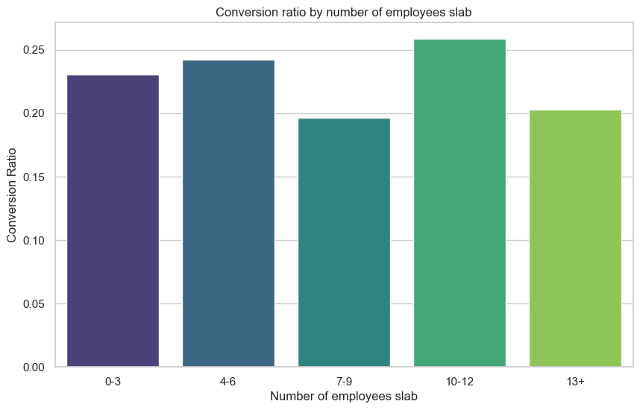
Conversion Ratio v/s Number of Employees
Conclusion:
No major trend was
identified in the conversion ratio considering the
available data on the
number of employees of the lead.

Slide 8
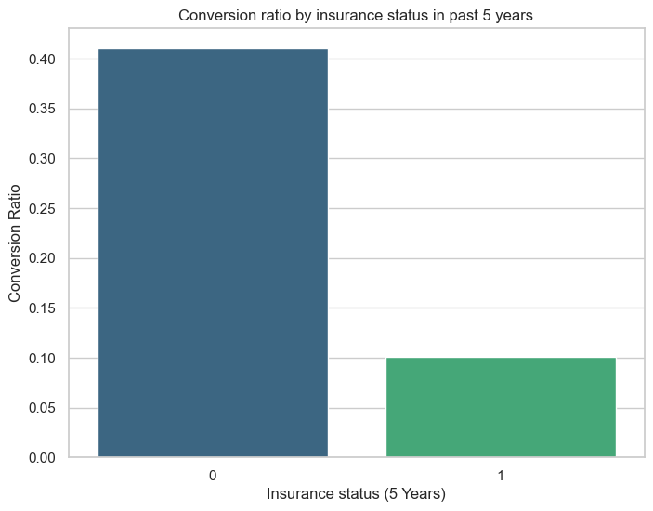
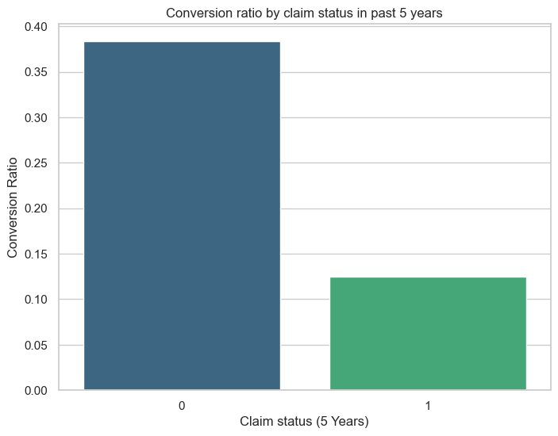
CR with insurance and claims in last 5 years
Conclusion:
Conversion rates are higher for entities with no insurance history in the last 5 years.
The data represents that majority of the entities purchasing insurance for the first time and could be new to the business.
Conclusion:
Conversion rates are elevated for entities with a clean claims history in the last 5 years.
This indicates that the greatest business opportunities come from entities with a secure and promising track record in terms of loss history.

Slide 9
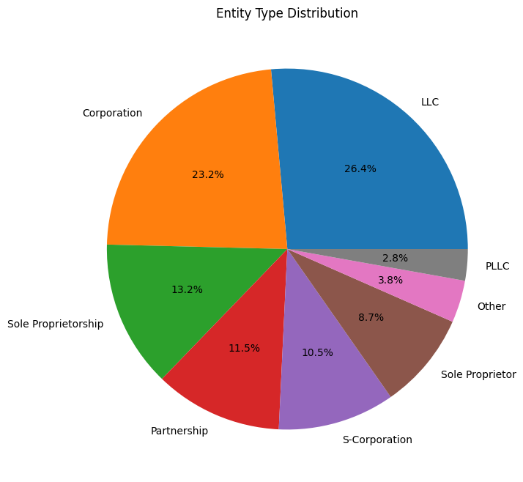
Entity Type Distribution
Conclusion:
The available lead data indicates that the majority of the opportunities are generated of the following entity types:
LLC
Corporation
Sole Proprietorship
Partnership.

Slide 10
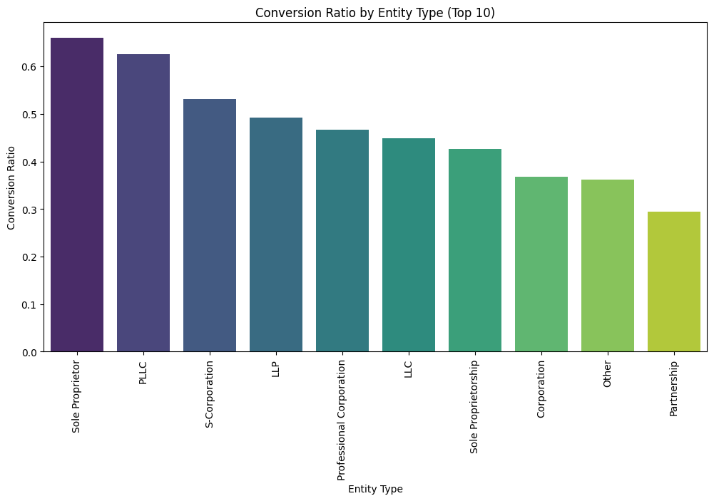
CR for different Entity types
Conclusion:
Corporations, as an entity type, make a major contribution to the total number of opportunities. However, their conversion rate is comparatively lower.
The other three major contributors to opportunities—LLC, Sole Proprietorship, and Partnership—are also performing well when it comes to conversions.

Slide 11
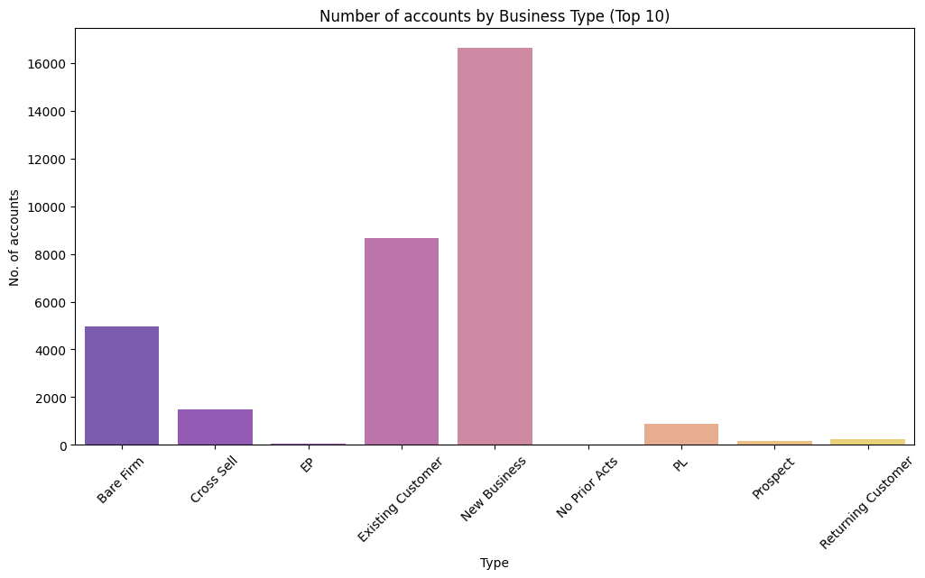
Number of accounts for different Business types
Conclusion:
New Businesses and Bare Firms contributes to the Highest number of accounts.

Slide 12
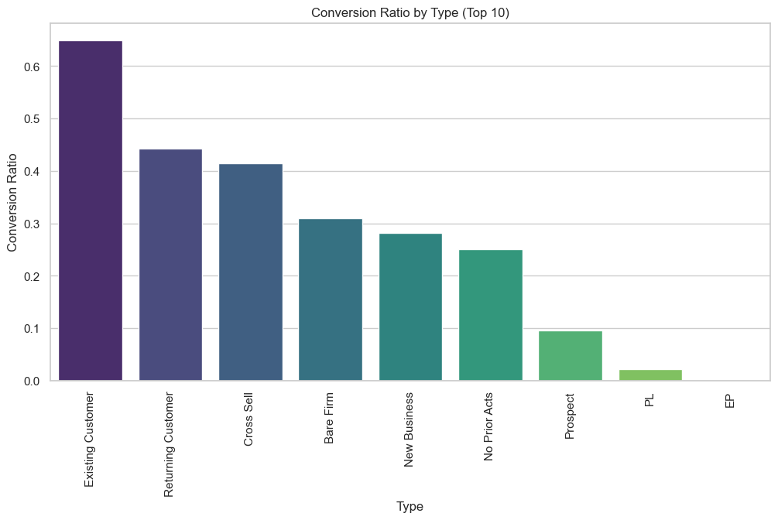
Conversion ratio for different business types
Conclusion:
While Bare Firms and New Businesses are the highest contributors, they exhibit a lower conversion rate of approximately 0.3

Slide 13
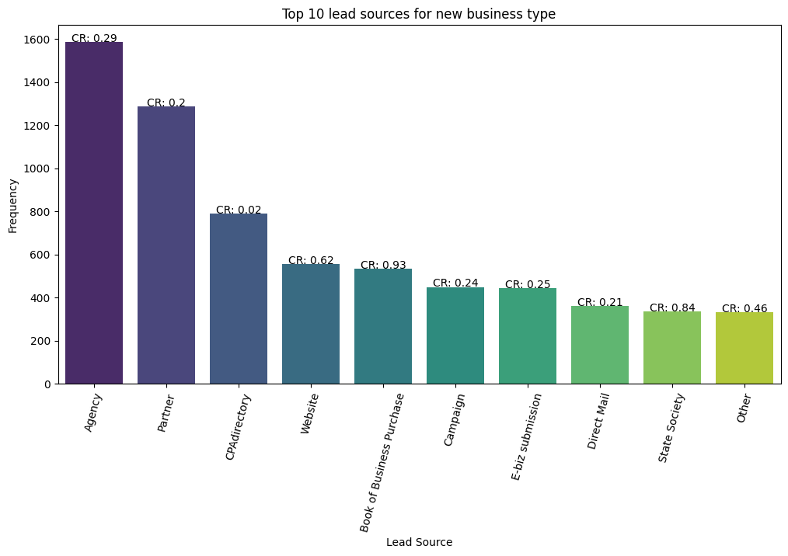
Conversion ratio for New Businesses
Conclusion:
Agency, Partner, and CPAdirectory have the lowest conversion ratio.
Magazines, Websites and State Society has the highest conversion ratio.

Slide 14
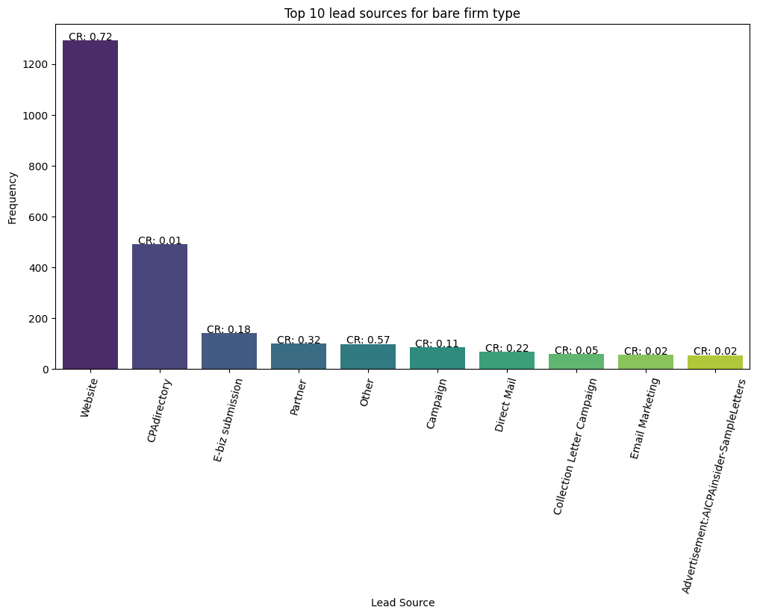
Conversion ratio for Bare Firms
Conclusion:
CPAdirectory have the lowest conversion ratio but have the second highest contribution.
Website have the highest conversion ratio and the highest contribution.

Slide 15
Leads

Slide 16
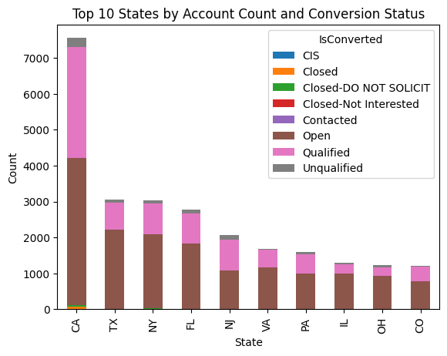
Conversion ratio for top 10 popular states
Conclusion:
CA, TX, NY has highest number of leads and so highest number of opportunities

Slide 17
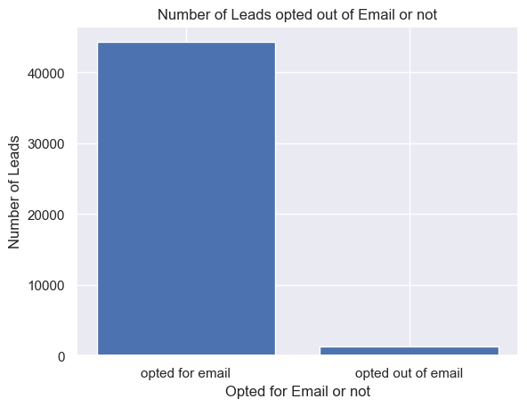
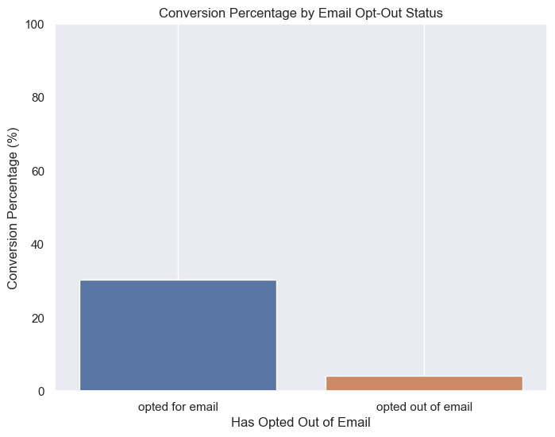
CR when opted for Emails
Conclusion:
Most of the leads have opted for Emails and have higher conversion percentage comparatively.

Slide 18
Conversion rate and median conversion time v/s Titles
Conclusion:
Owner, Mr., President, Partner and CPA are contacted the highest number of times
CEO, Managing manager, Sole Proprietor have higher conversion percentage
Higher the time taken lower the conversion chances
Average time taken=174 days

Slide 19
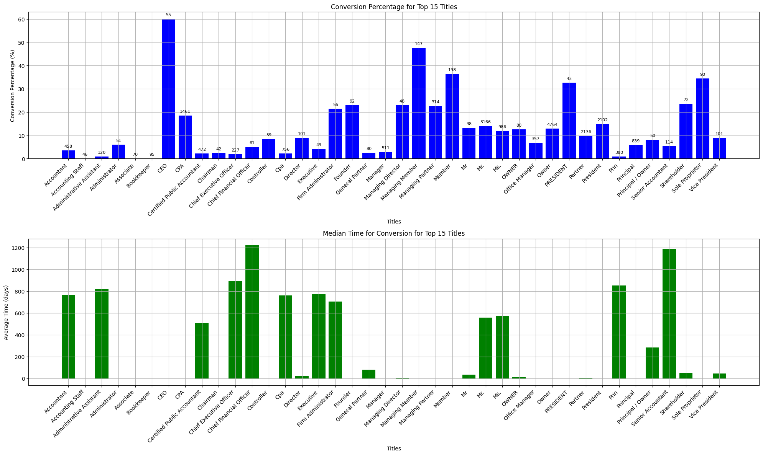

Slide 20
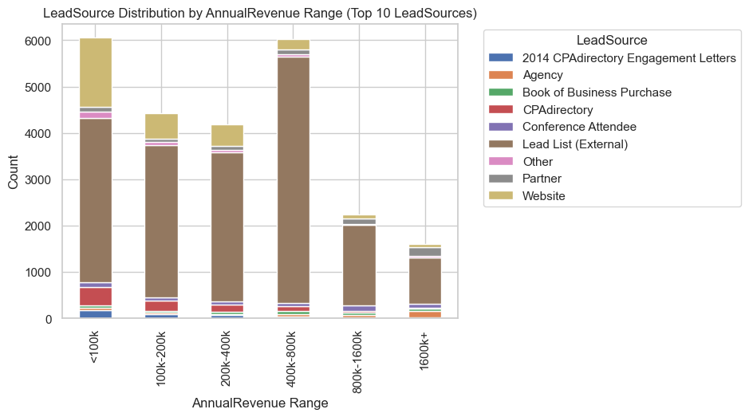
Lead Source v/s Annual Revenue
Conclusion:
Lead list(External) is the key contributors to generating leads across all revenues
Website and CPAdirectory are the primary contributors to generating leads with low annual revenues.

Slide 21
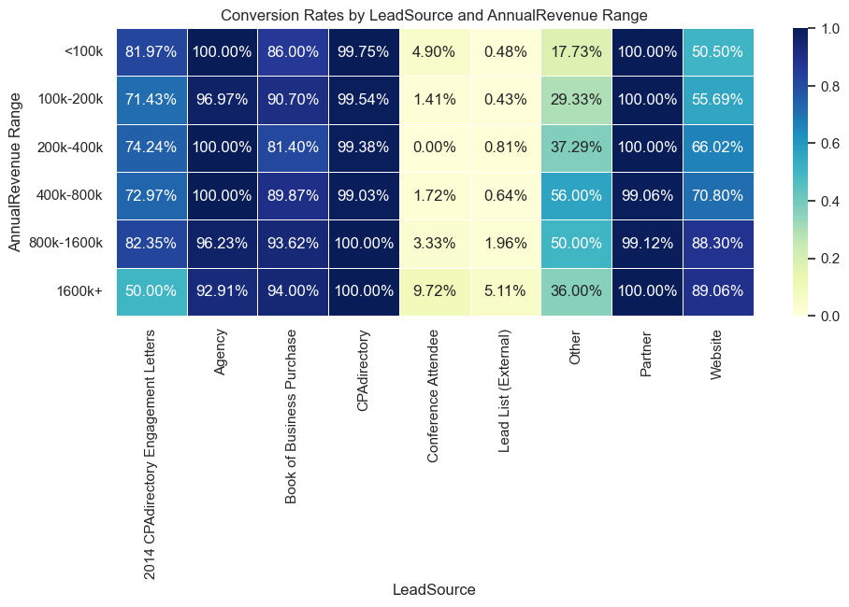
HeatMap: Lead Source(X) vs Annual Revenue(Y) for top 10 lead sources
Conclusion:
Agency, Magazines, CPAdirectory and Partners consistently exhibit a high conversion ratio across all revenue brackets.
In contrast, Lead List and Conference Attendee shows an almost negligible conversion ratio across all brackets.
Website displays a lower conversion ratio for leads with lower annual revenue, compared to the higher annual revenue.

Slide 22
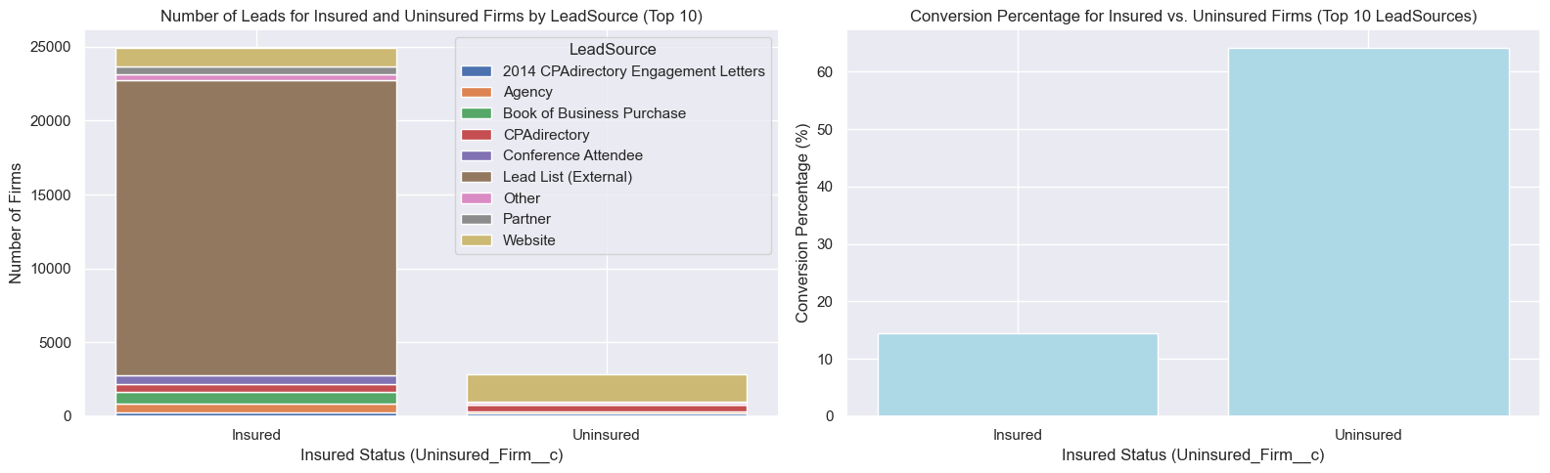
CR v/s firm is insured or not
Conclusion:
Uninsured firm leads have higher conversion percentage compared to Insured firms. Most of the leads are Insured firms
Lead list (external) is the most popular lead source for insured firms and have lowest conversion rate(~0%).
Websites is the most popular lead source for uninsured firms and has a good conversion rate

Slide 23
Analyzing sales variance across states

Slide 24
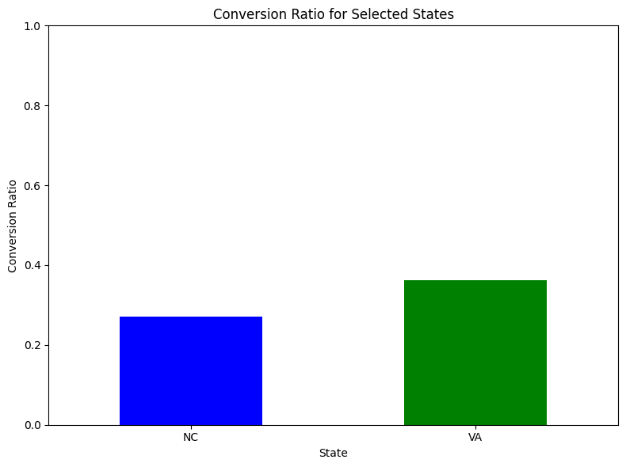
Conversion ratio comparison between Virginia and North Carolina

Slide 25
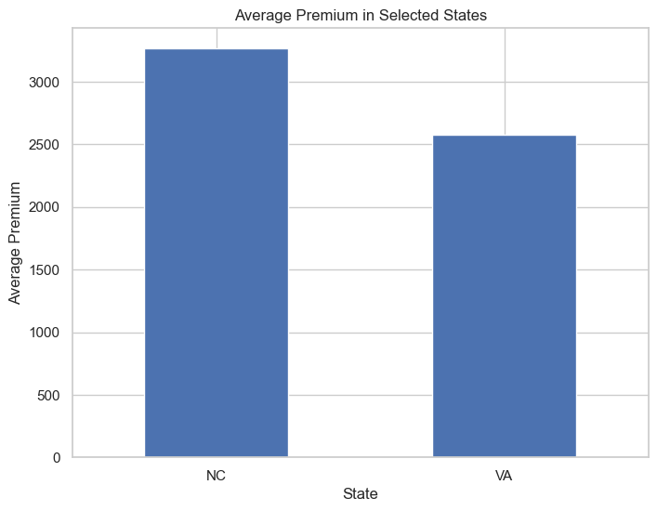
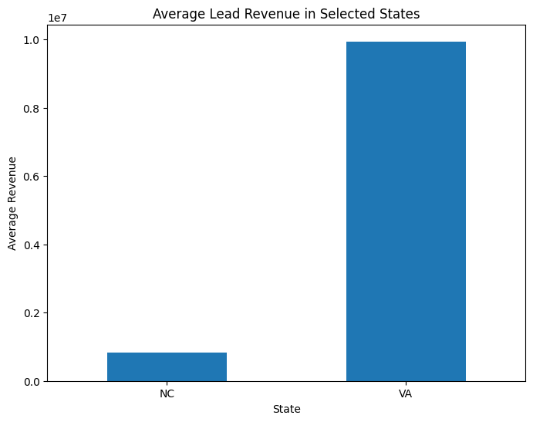
Average premium and average revenue comparison
Conclusion:
The Average premium in North Carolina is higher than Virginia.
Conclusion:
The Average revenue in Virginia is higher than North Carolina.

Slide 26
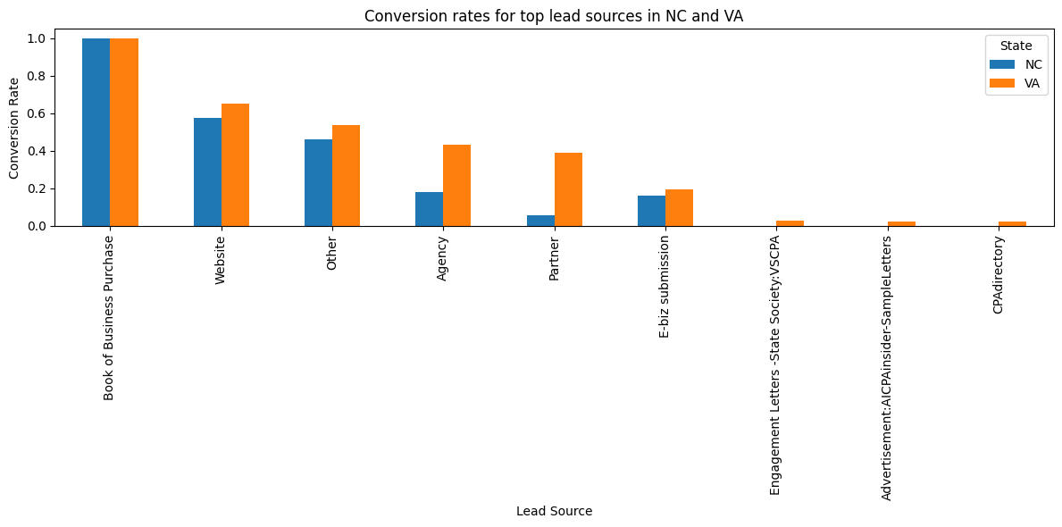
Conversion rates comparison of lead source
Conclusion:
The Agency, partner, and website have higher conversion rates in the Virginia but not in North Carolina.

Slide 27
Thank You

Slide 28
CAMICO DATASET
(28-09-2023)
Presented By :
Spectral Tech Analytics Team

Slide 29
Content
Camico Dataset insights
Model training - Leads
Model training - opportunities
Model training - Lamb Worker Compensation dataset

Slide 30
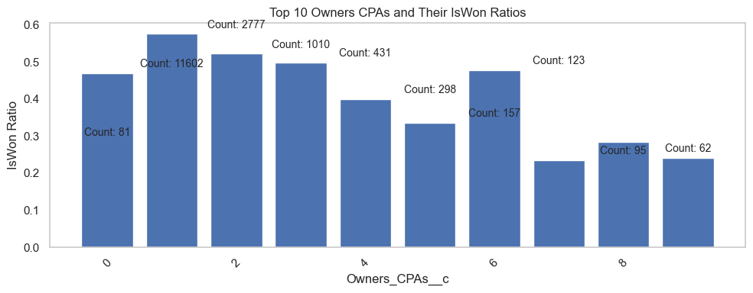
Opportunities - Owner’s CPAs
Conclusion:
As the Owner’s CPAs increases, Conversion percentage decreases.
20k missing values in 36k opportunities

Slide 31
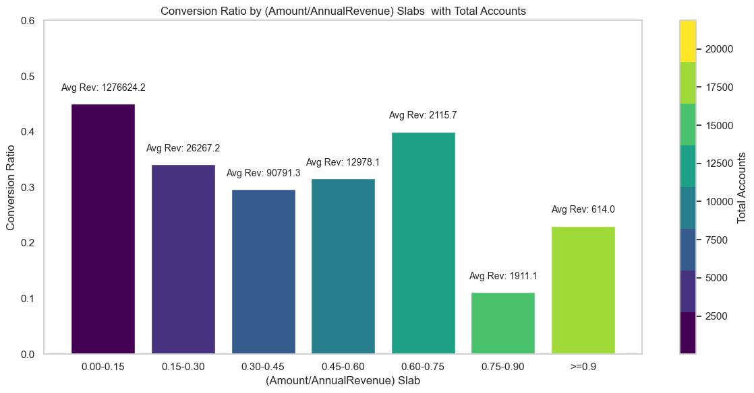
Amount v/s Conversion
Conclusion:
Amount and Annual Revenue are not linearly dependent
Accounts with low Annual Revenue have higher (Account/Annual Revenue) ratio.
Most of the accounts lie in lower Annual Revenue range
Conversion ratio inversely proportional to (Amount/Annual revenue) ratio

Slide 32
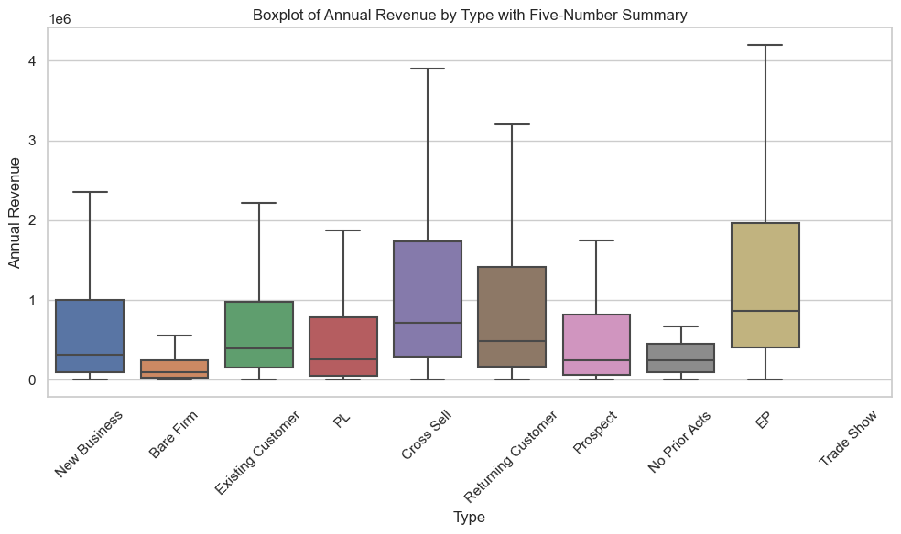
Business Type
Conclusion:
Shows the annual revenue distribution for different business types.
Bare Firm, No Prior Acts, PL and Prospect have lowest median revenues

Slide 33
Actionable insights
For Lead Sources v/s Revenue:
High revenue opportunities - make product more premium/services for leads from sources such as Magazines, Agencies and partners
Low premium opportunities - give discounts or make the insurance cheaper for opportunities from Websites, E-biz submissions
CPA directory has 0% conversion for all slabs, can focus on other Lead sources
For different accounts/Business types : For lower Annual Revenue opportunities (Bare Firm, No prior Acts, New Business), lowering the Amount value might increase conversion percentage.

Slide 34
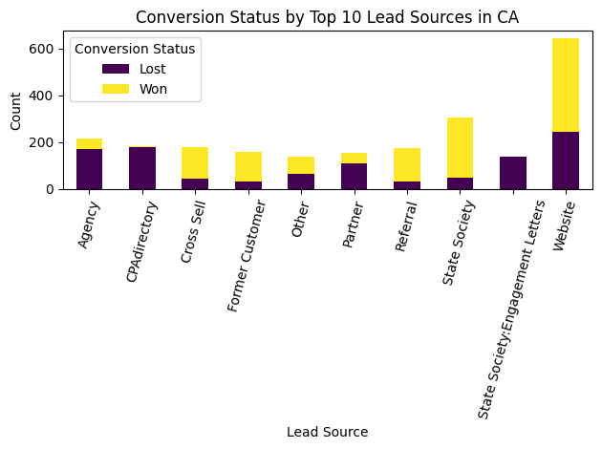
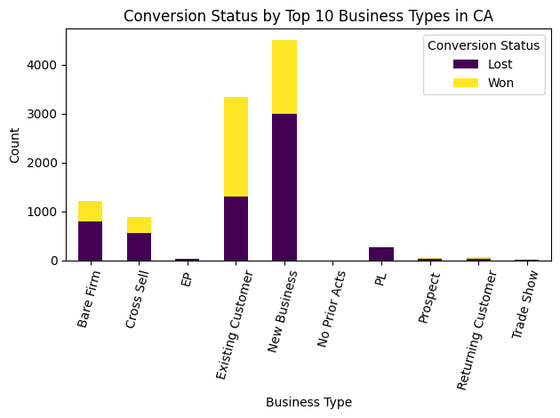
Analysis for state CA
Conclusion:
In state CA, websites creates highest opportunities, followed by State society, Agency, CPAdirectory and so on.
Agency, CPAdirectory, Engagement letters and partners have lower conversion rates.
Websites, state society, referral and cross sell have higher conversion rates.
New Business, Existing customer and Bare firm creates most opportunities.

Slide 35
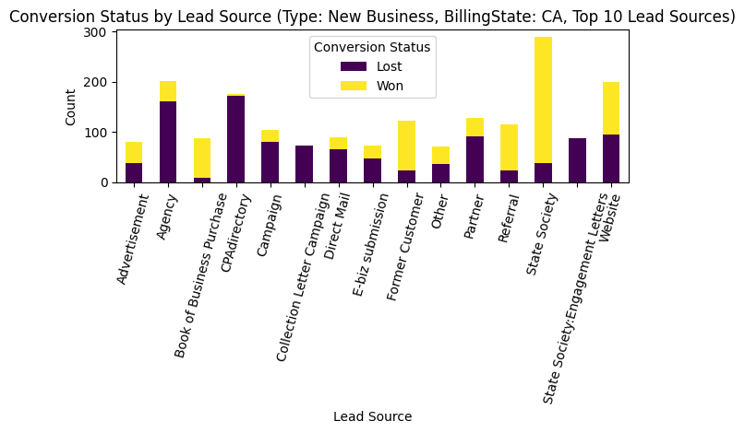
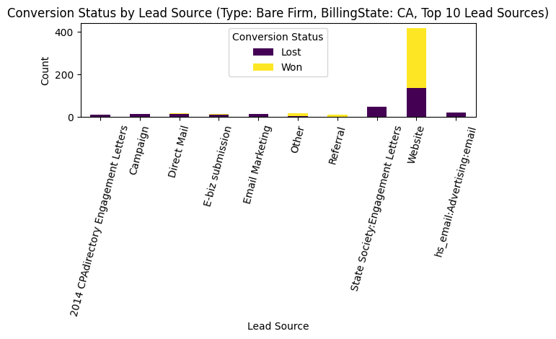
Analysis for state CA
Conclusion:
For opportunities for New Business type, CPAdirectory, campaign and Agency does not work very well, State society, and former customers have good conversion rates though
For opportunities for Bare Firm type, most of the opportunities comes through website and have good conversion rate.

Slide 36
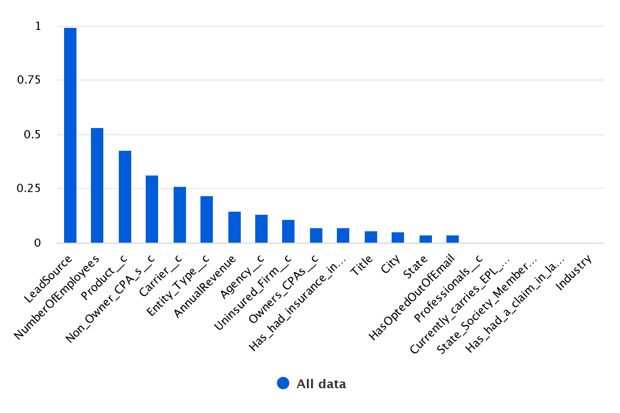
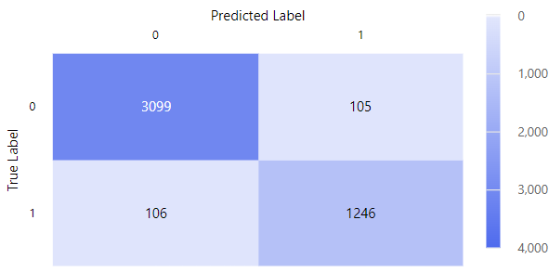
Leads - Model Training results
Conclusion:
Lead Source and Number of Employees are the most important features to predict the Leads to Opportunities conversion
Model : Voting Ensemble, good on biased dataset, missing values
Trained on : Leads table (13k-Converted , 32k-Not converted)
Dataset split 90-10 for train and testing
Weighted AUC - 99% accuracy

Slide 37
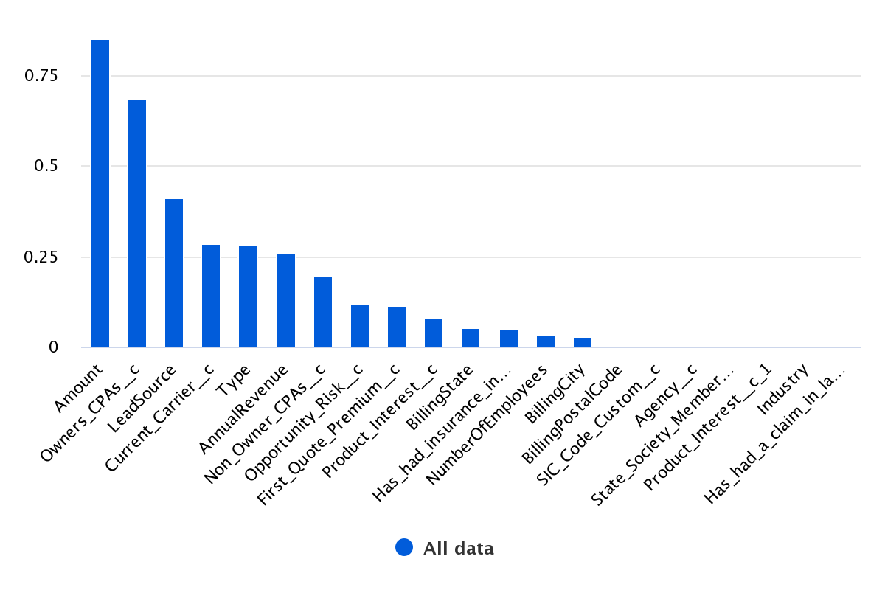
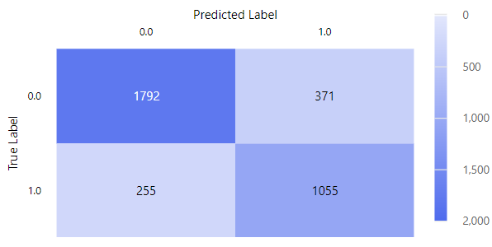
Opportunities - Model Training results
Conclusion:
Amount, Owner’s CPA, Lead Source and Type are the most important features to predict the Leads to Opportunities conversion
Model : Voting Ensemble, good on biased dataset, missing values
Trained on : Leads table (13k-Converted , 21k-Not converted)
Dataset split 90-10 for train and testing
Weighted AUC -90%

Slide 38
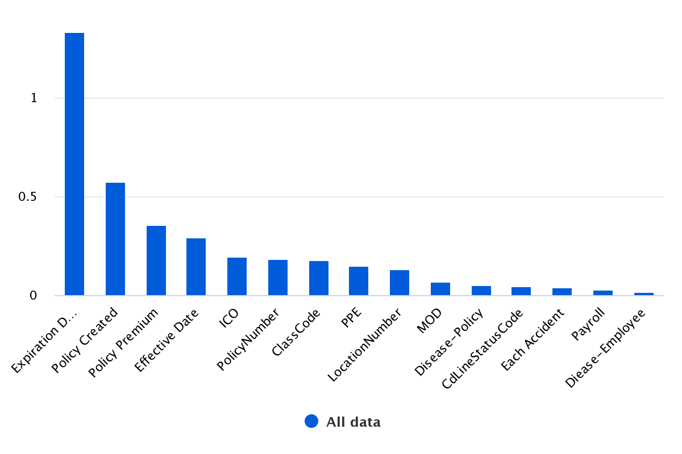
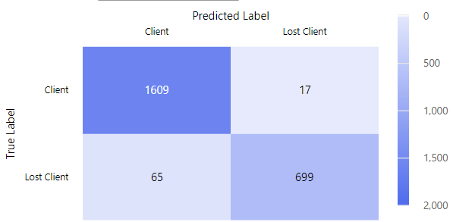
Lamb Worker Compensation Dataset
Conclusion:
Expiration date, policy created data and policy premium are the most important features to predict the wins and losses
Model :Random Forest, good biased dataset
Trained on : Lamb table (16k-Clients, 8kk-Lost clients)
Dataset split 90-10 for train and testing
Accuracy -96%(91-Lost, 98.9-Won)

Slide 39
Camico : Opportunity Insights

Slide 40
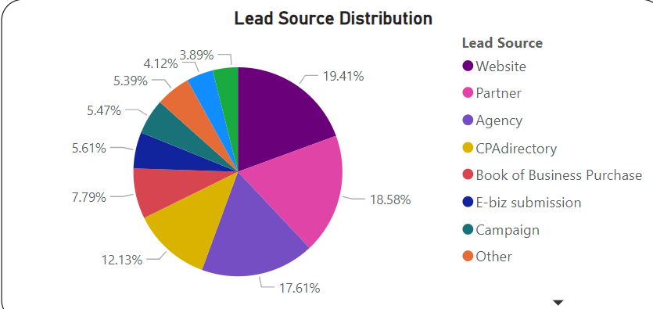
Insights : Lead Source Distribution
Conclusion:
The leading contributors of lead generation are:
Partner
Website
Agency
CPAdirectory
These sources stand out as the primary contributors to generating opportunities.

Slide 41
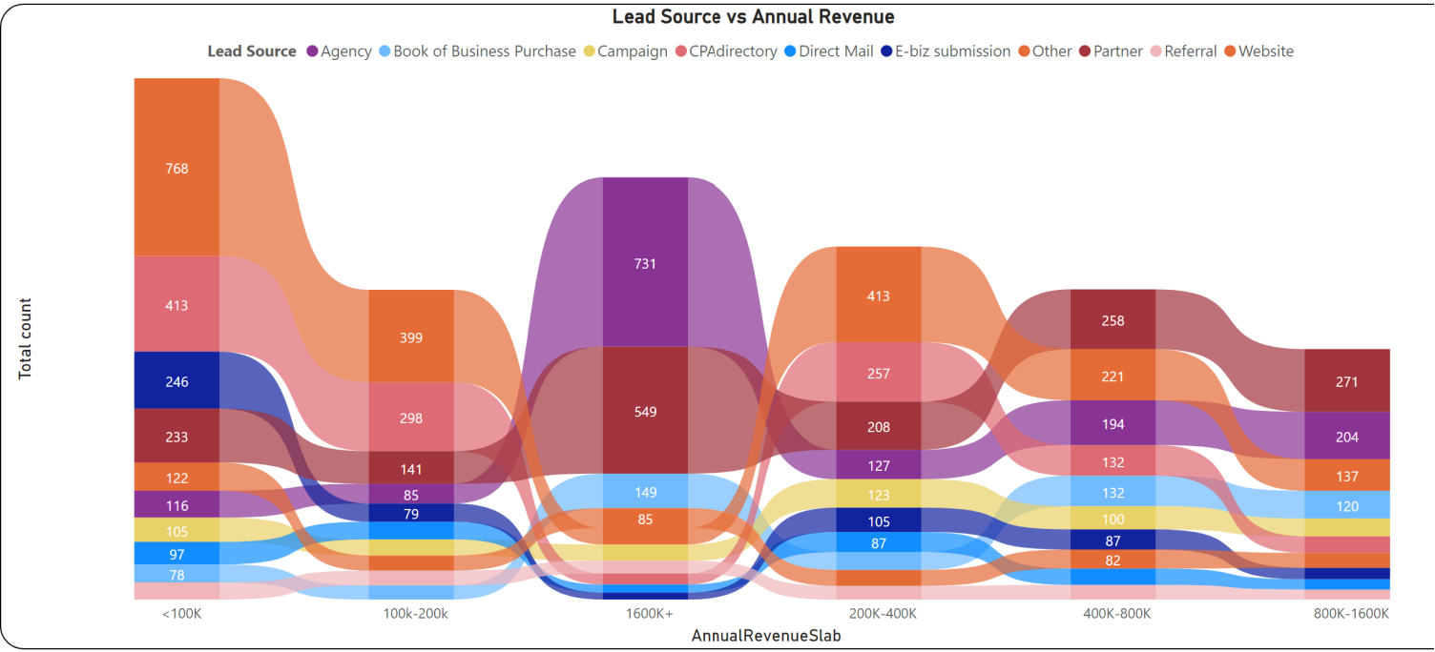
Insights : Lead Source v/s Annual Revenue
Conclusion:
Elevate annual revenues with Agency and Partner for high annual revenue
Website and CPAdirectory drive opportunities for low annual revenue

Slide 42
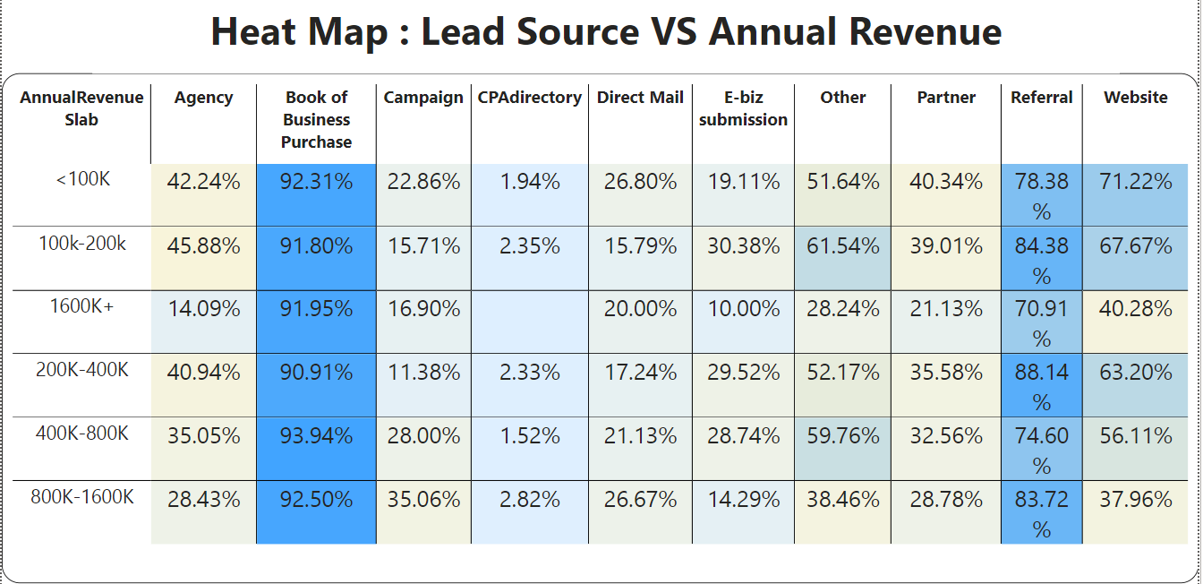
Insights : HeatMap for Lead Source(X) vs Annual Revenue(Y)
Conclusion:
Prioritize efforts on leveraging Referrals and Book of Business Purchase
Optimize the website for both high and low revenue leads
Approach CPAdirectory cautiously as it registers lowest conversion rates
Consider a balanced approach for Other Lead Sources, Agencies, and Unspecified Sources based on further analysis to maximize sales conversions

Slide 43
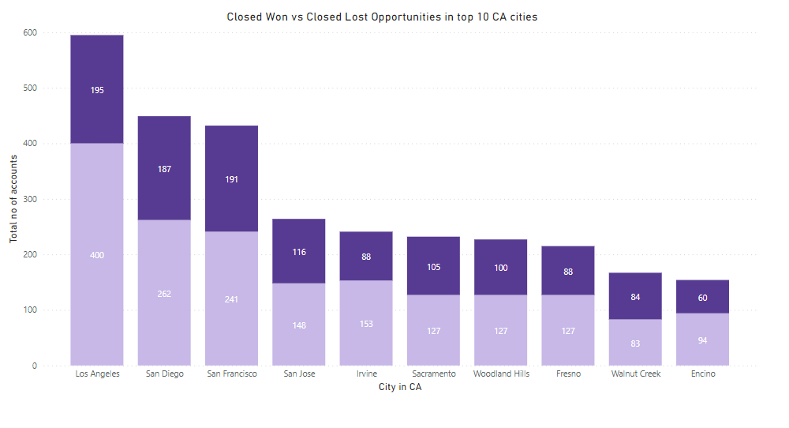
Conversion Comparison in CA Cities
Conclusion:
No significant variation or trend was observed in the Conversion Ratio across different cities.
Across almost all cities, approximately 35% of leads are successfully closed as 'won,' while the others are marked as 'lost'.

Slide 44
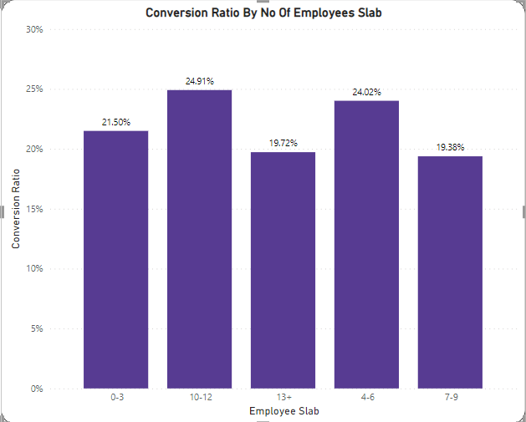
Conversion Ratio v/s Number of Employees
Conclusion:
The available data on the number of employees of the lead did not reveal any significant trend in the conversion ratio.

Slide 45
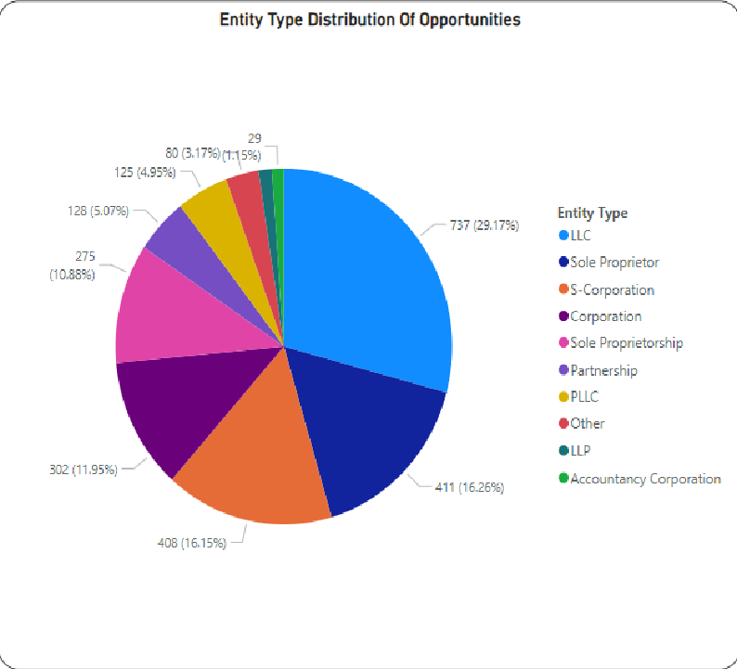
Insights : Entity Type Distribution
Conclusion:
The data reveals that a significant portion of opportunities stem from the following business entities:
a)LLCs
b) S-Corporations
c) Sole Proprietor
d) Corporation

Slide 46
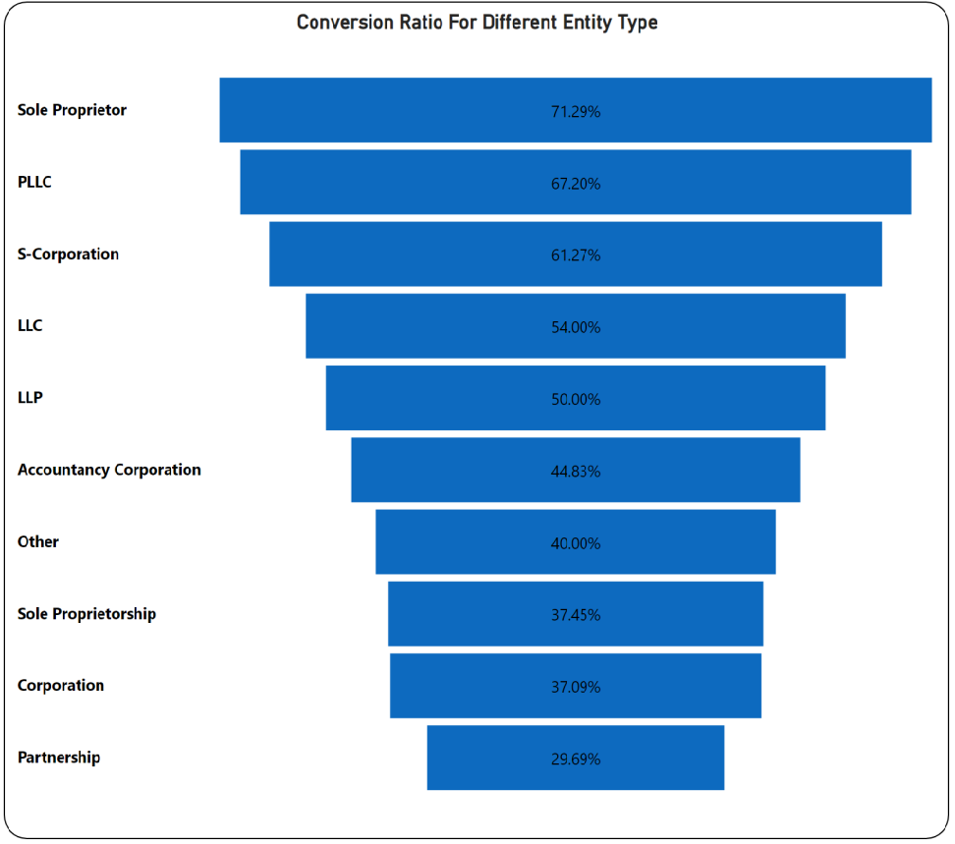
Insights : Different entity types
Conclusion:
Corporations Impact:
Major role in opportunities.
Lower conversion rate.
Top Performers:
1)Sole Proprietor,PLLC:Strong contributor and solid conversion.
2)LLC:Notable presence and commendable conversion.
3)LLP:Significant contribution and impressive conversions.
In essence, Corporations lead in opportunities but lag in conversion, while LLCs, Sole Proprietor, and PLLC excel in both generation and conversion.

Slide 47
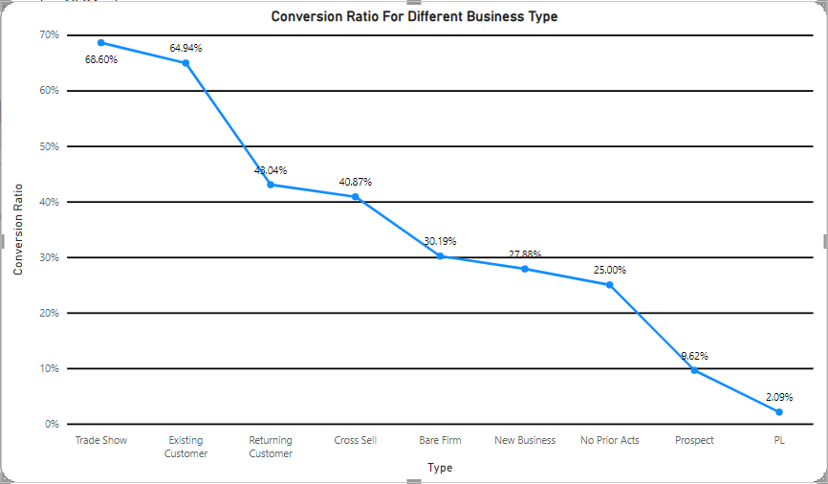
Insights : Different business types
Conclusion:
Bare Firms and New Businesses play a substantial role in lead generation but exhibit a lower conversion rate.
Focusing on improving the conversion strategies specifically for these segments could potentially enhance overall sales effectiveness.

Slide 48
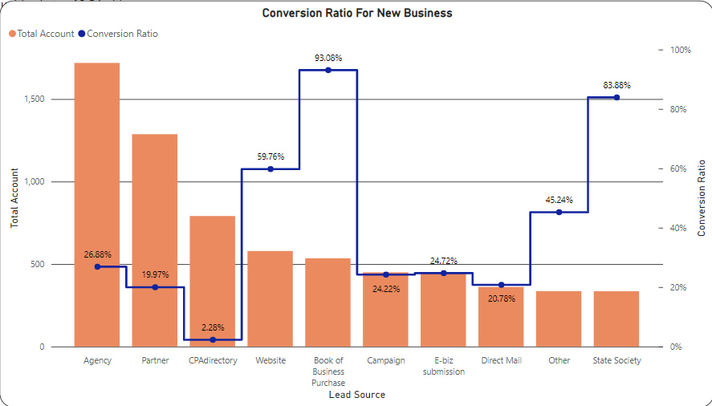
Insights : New Businesses
Prioritize efforts towards sources like Books of Business Purchases, Websites, and State Society due to their higher conversion ratios, despite lower account volumes.
Evaluate strategies for Agency, Partner, and CPAdirectory to enhance their conversion rates despite their higher account numbers, emphasizing the need to improve lead quality or revise sales approaches.

Slide 49
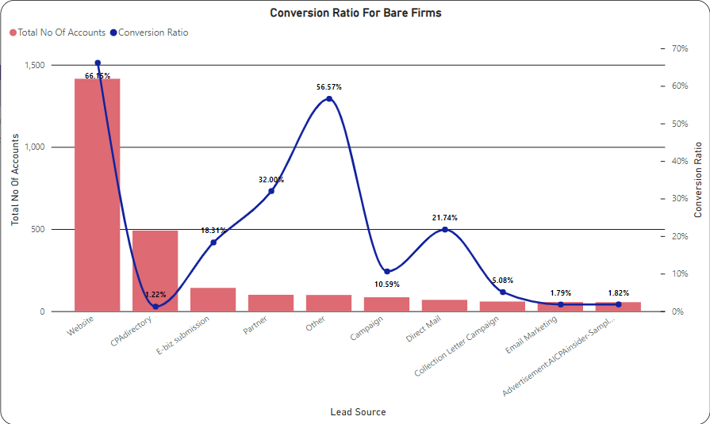
Insights : Bare Firms
Conclusion:
While CPAdirectory shows a low conversion ratio despite being the second-highest contributor, the Website stands out with both the highest conversion ratio and highest contribution.
Prioritizing strategies to optimize CPAdirectory conversion rate while maintaining and enhancing the Website's performance can significantly impact overall sales effectiveness.

Slide 50
Insights : Top 10 popular states
Conclusion:
States such as California, Texas, and New York boast the highest volume of leads and consequently present the most opportunities.
Focusing sales efforts and strategies towards these regions might yield significant potential for lead conversions and business growth.

Slide 51
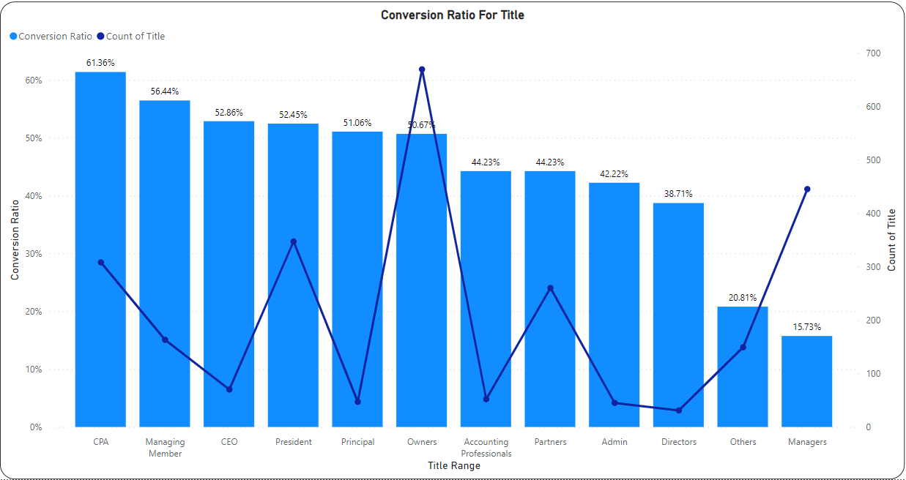
Insights : Contact title v/s time
Conclusion:
Certain titles like Owner, Mr., President, Partner, and CPA receive the most contacts, highlighting their relevance or visibility.
Conversely, titles such as CEO, Managing Manager, and Sole Proprietor exhibit higher conversion percentages, indicating a higher likelihood of successful closures.
Notably, there's an inverse relationship between the time taken and conversion chances, with an average time of 174 days taken to convert leads into successful closures. Streamlining processes to reduce conversion time might improve overall sales outcomes.

